Slide 1
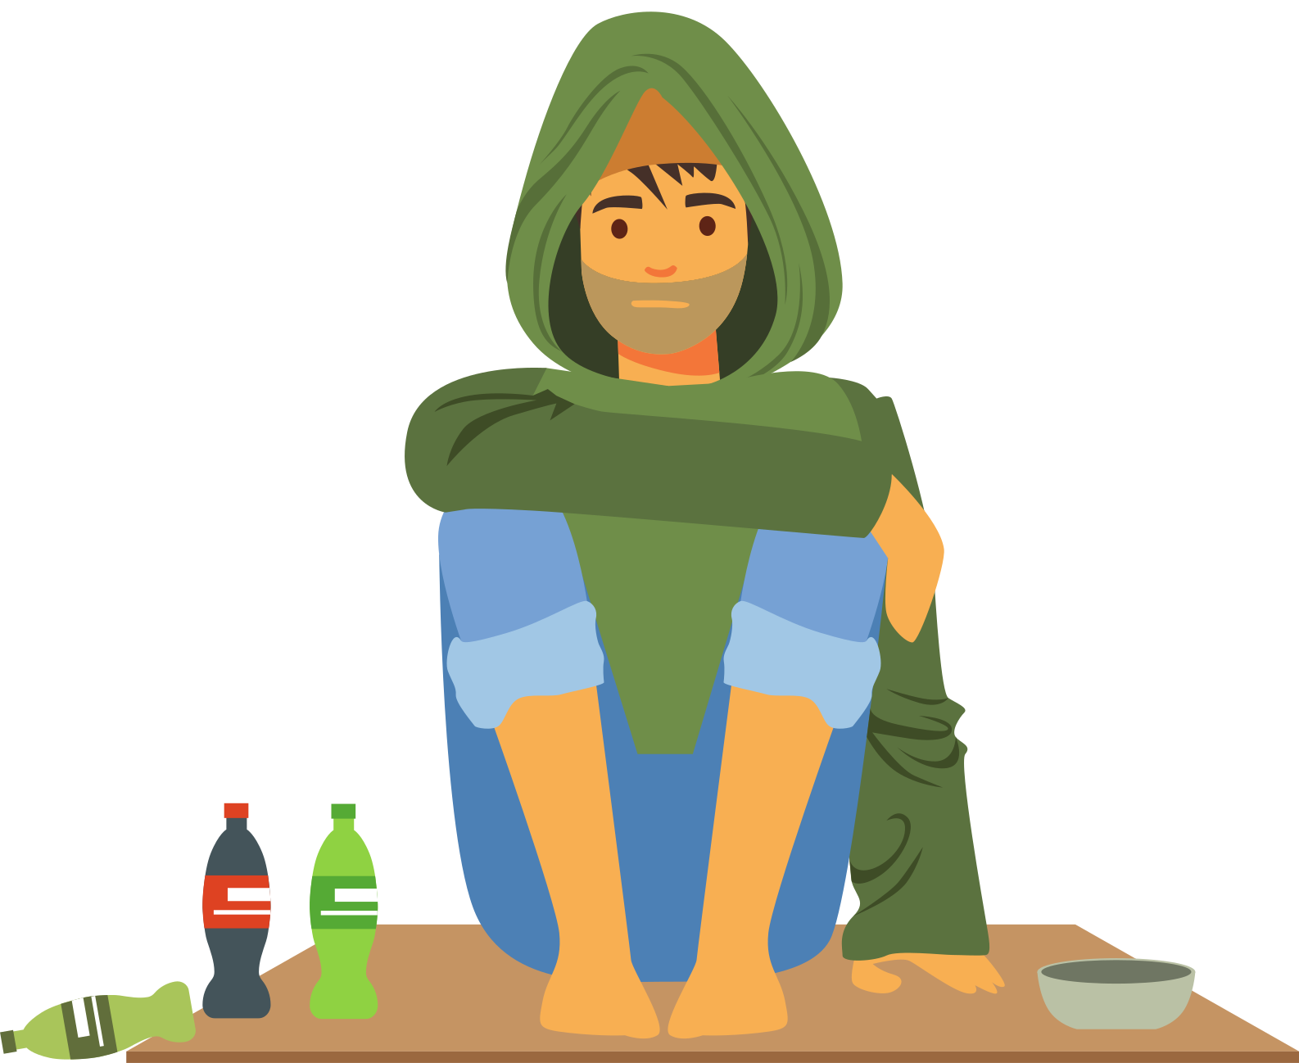
Inequality and Poverty
3.4
Copyright Bananaomics

Slide 2
What are the 3 main objectives of an economy?
Copyright Bananaomics

Slide 3
3 Macro Objectives
Economic Growth
Low Unemployment Rate
Low and Stable Inflation
Possible additional goals: Sustainable Debt, Equity, and Income Distribution
Copyright Chandler Bell

Slide 4
Do most economies in the world today promote equality?
What are the barriers to equality?
Copyright Bananaomics

Slide 5
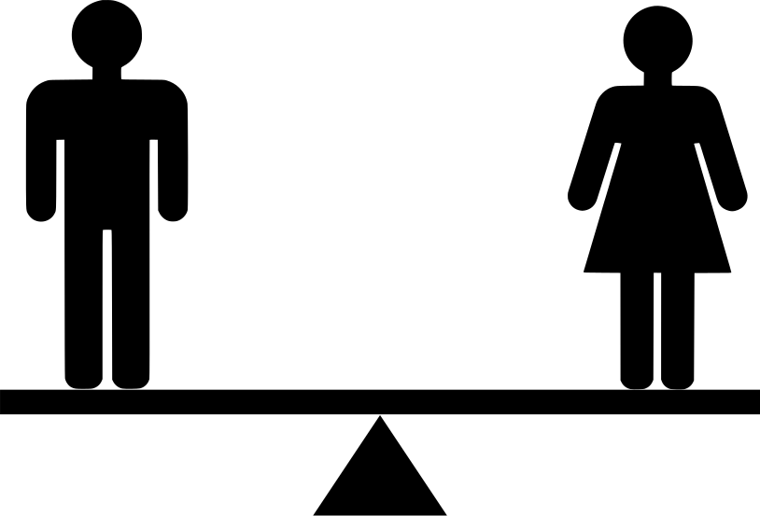
Definition
Equality
Situations where economic outcomes are the same for all.
Copyright Bananaomics

Slide 6
Definition
Equity
Refers to the idea of fairness. Different people are given different things to promote equity.
Copyright Bananaomics

Slide 7
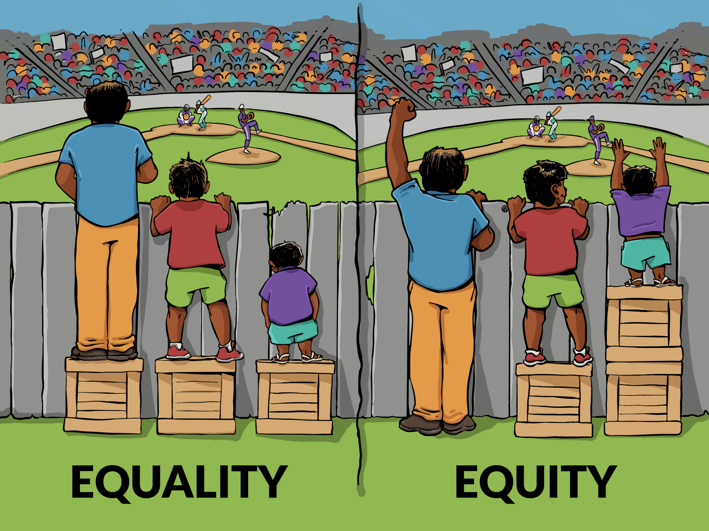
Equity vs Equality
Interaction Institute for Social Change | Artist: Angus Maguire.”
Copyright Bananaomics

Slide 8
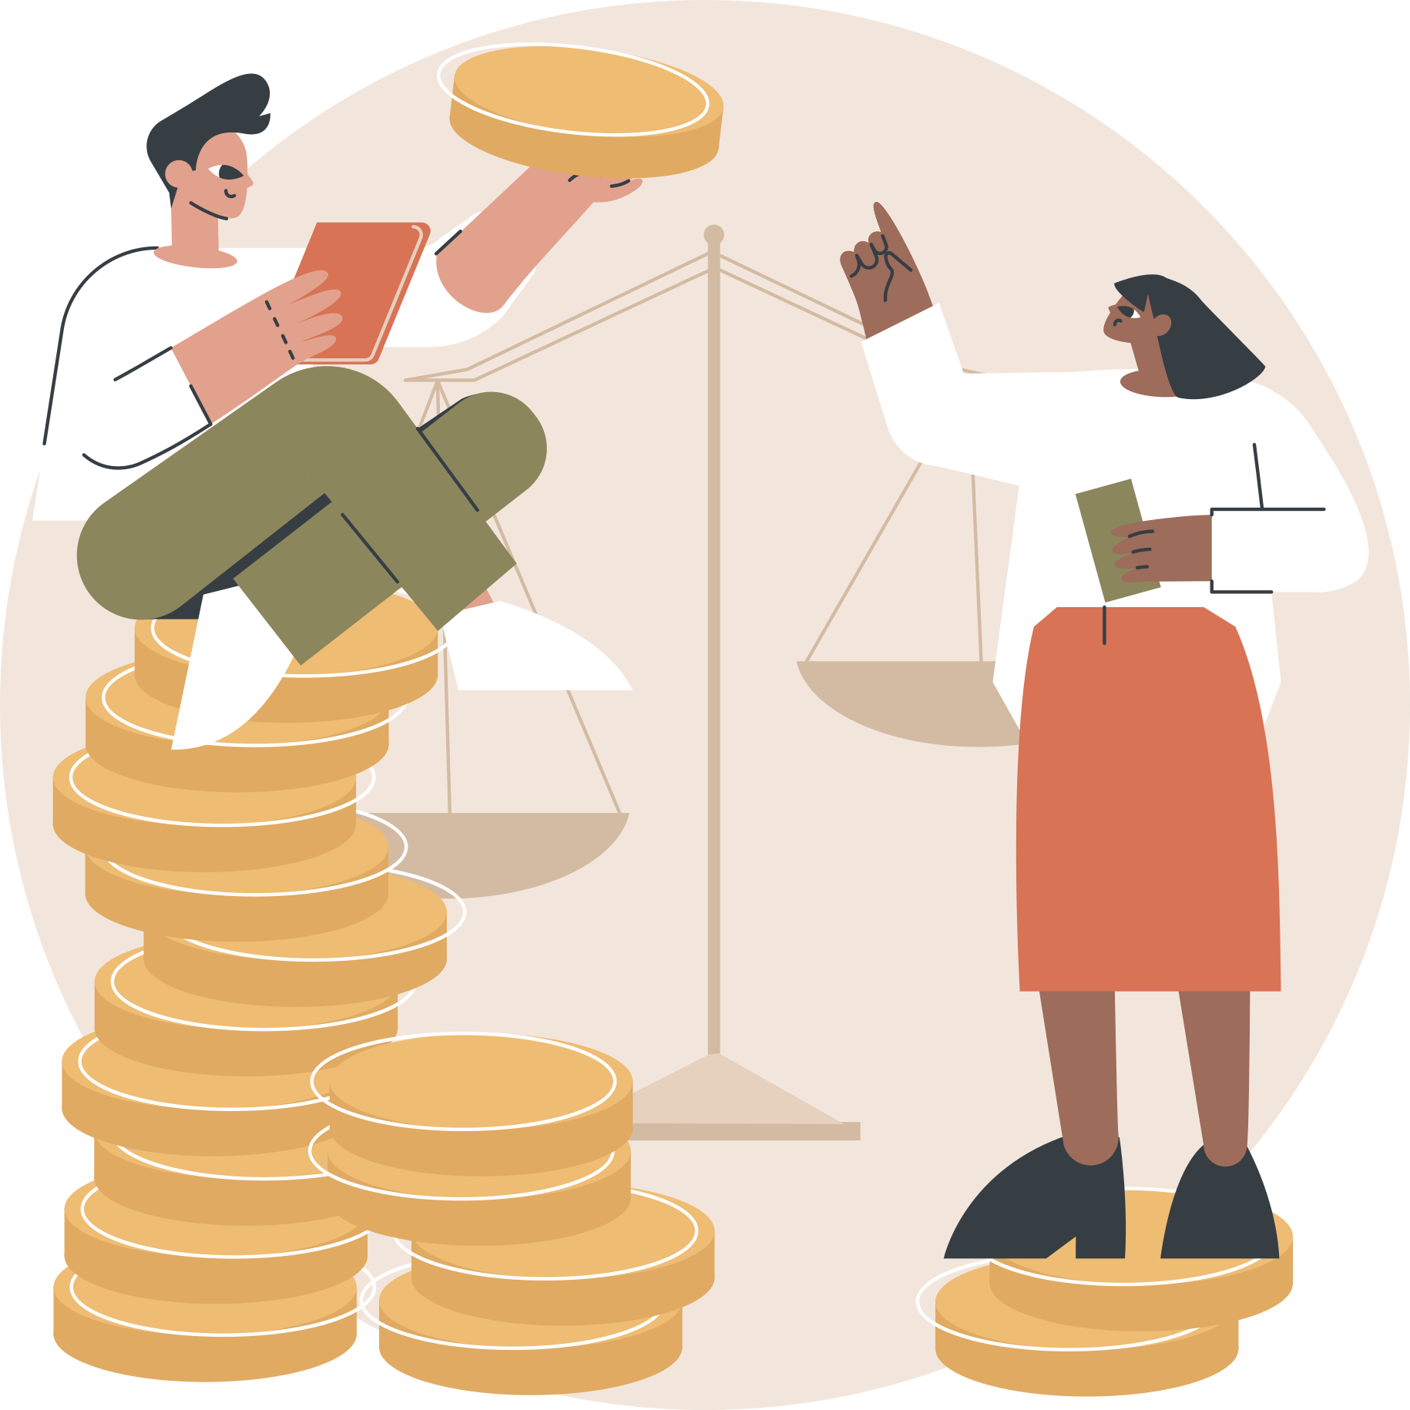
Definition
Economic Inequality
unequal distribution of wealth, assets, or incomes in society. Sometimes referred to as the "wealth gap".
Copyright Bananaomics

Slide 9
Definition
Social Mobility
The ability of people to climb or fall within the economic sectors of society.
Copyright Bananaomics

Slide 10
Wealth Gap

Slide 11
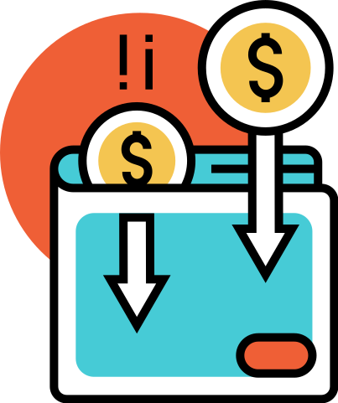
Most Notable Types of Economic Inequality
Unequal Distribution of Income
Unequal Distribution of Weath
Copyright Bananaomics

Slide 12
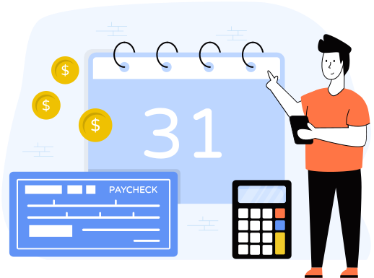
Unequal Distribution of Income
Capitalist, market-based systems are the most efficient economic systems in regard to resource allocation. While equal incomes may not be the goal, high inequality should be combated for economic growth.
Solutions
Universal Basic Income (UBI)
Universal transfer payment to every citizen to raise income levels.
Increase in Progressive Income Tax
Copyright Bananaomics

Slide 13
Unequal Distribution of Wealth
Wealth is passed from generation to generation, unlike income. Wealth provides generations of families with greater educational opportunities, high standards of living, and effective healthcare.
Solutions
Wealth Taxes
Philanthropy
Wealthy individuals choosing to give back to society through donations.
Copyright Bananaomics

Slide 14
Measuring Economic Inequality
Copyright Bananaomics

Slide 15
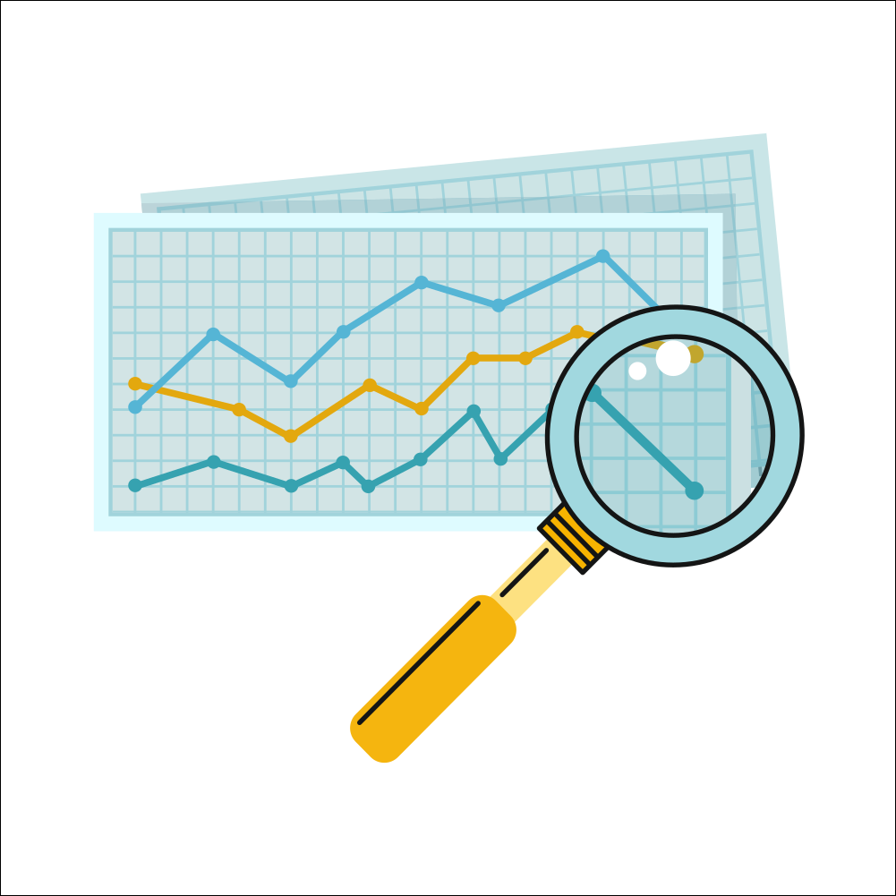
The Gini Coefficient & The Lorenz Curve
Copyright Bananaomics

Slide 16
The Gini Coefficient
Definition
Measure of distribution of income within an economy. This coefficient is usually used to determine the level of income inequality.
The higher the Gini - the more unequal the income distribution
The lower the Gini - the closer to income distribution equality
Copyright Bananaomics

Slide 17
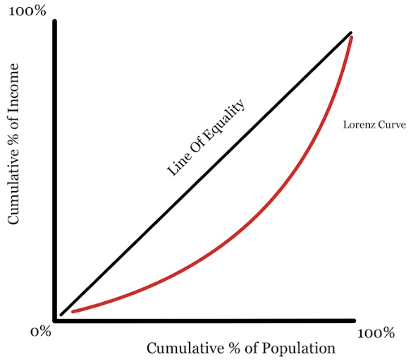
The Lorenz Curve
Copyright Bananaomics

Slide 18
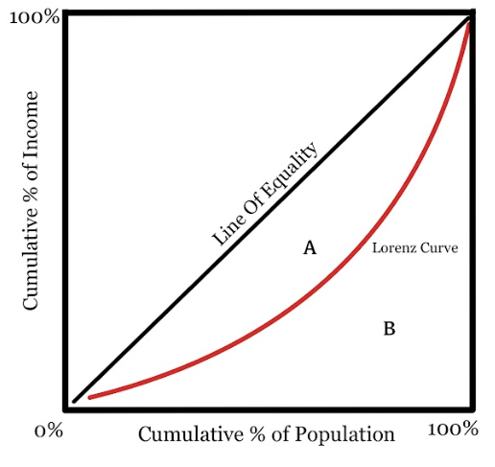
The Lorenz Curve
Representation of the Income Inequality. It shows the difference between perfect equality of income and the current status of a country's income equality by using the Gini Index.
The Gini Coefficient is represented by the area between the Lorenz curve and the line of perfect equality. (A)
Gini = A / (A+B)
Copyright Bananaomics

Slide 19
Practice
The United Kingdom has a Gini coefficient of 43.
Thailand has a Gini coefficient of 38.
Determine which country has a larger gap in regard to income equality.
Draw a representation using the Lorenz curve demonstrating their income equality status.
Copyright Bananaomics

Slide 20
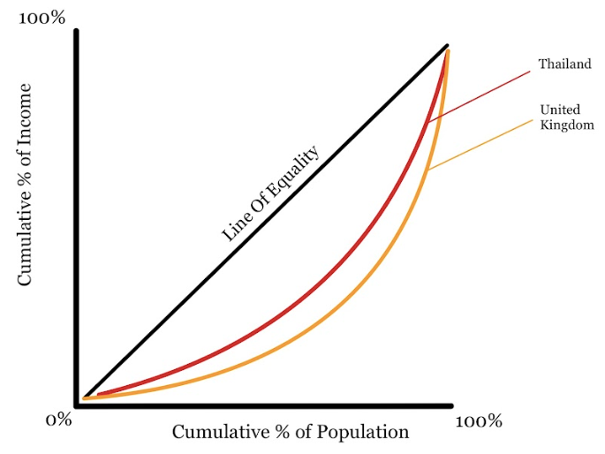
Practice
The United Kingdom has a Gini coefficient of 43.
Thailand has a Gini coefficient of 38.
Copyright Bananaomics

Slide 21
Gini and Lorenze Curve - Khan Academy

Slide 22
Practice Question
Copyright Bananaomics

Slide 23
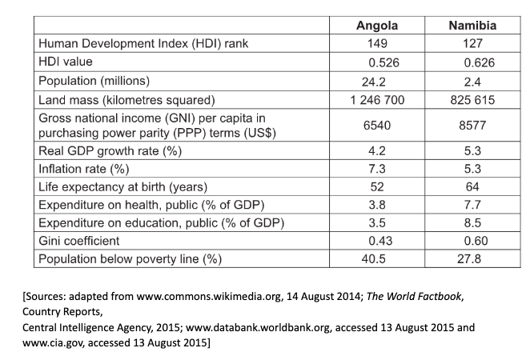
Practice Question
M17/3/ECONO/SP2/ENG/TZ0/XX
Copyright Bananaomics

Slide 24
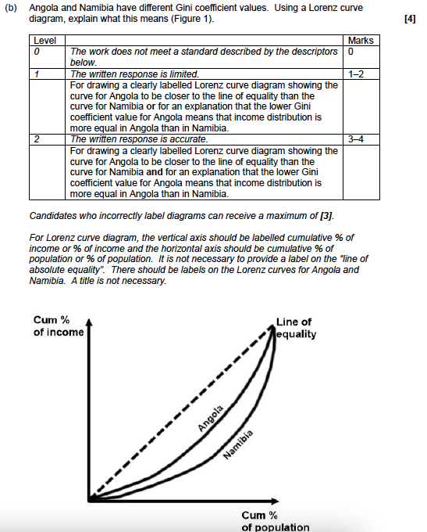
Mark Scheme
M17/3/ECONO/SP2/ENG/TZ0/XX
Copyright Bananaomics

Slide 25
The Lorenz Curve from Quintile Data
(HL Only)
Copyright Bananaomics

Slide 26
Quintile Data
To represent the income distribution more accurately, quintile data is used by dividing the population into 5 groups from poorest 20% to the richest 20%.
Copyright Bananaomics

Slide 27
Practice
Plot the Lorenz Curve for Libya using the Quintile Data Below
Copyright Bananaomics

Slide 28
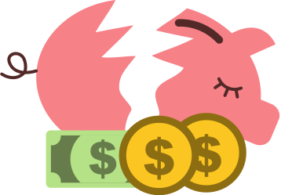
Absolute vs Relative Poverty
Copyright Bananaomics

Slide 29
Absolute vs Relative
Absolute Poverty
Poverty where people earn below internationally defined levels of income (USD 1.90 per day). People in absolute poverty lack access to basic necessities (food, education, shelter, etc.).
Relative Poverty
Making below the average level of income relative to their specific country.
Copyright Bananaomics

Slide 30
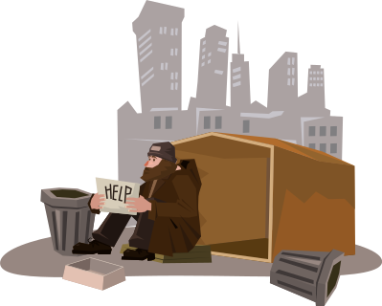
Measuring Poverty
Copyright Bananaomics

Slide 31
Single Indicators
Single indicators use only one factor to measure poverty.
Examples of single indicators that aim to measure poverty
International Poverty Line (Absolute Poverty)
Birth Rates
A high birth rate suggests that a large portion of the population is too young to be employed and financially dependent on older adults.
Primary Sector Dependency
The Primary Sector refers to sectors of an economy that extracts or uses natural resources such as agriculture, mining, or fishing.
Large informal economy
Minimum Income Standards
Each country typically has its own poverty line which can be used to determine the number of people in poverty.
Copyright Bananaomics

Slide 32
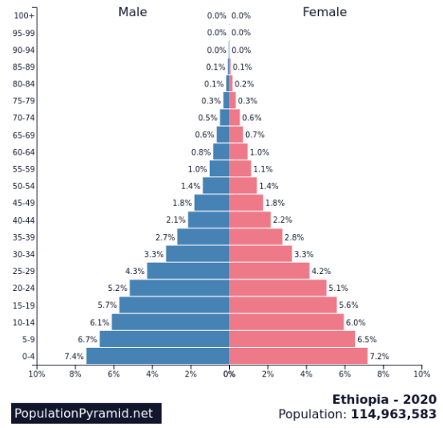
Birth Rate Example
Copyright Bananaomics

Slide 33
Composite Indicators
Composite indicators compile multiple single indicators to form an accurate measure of the multi-dimensional concepts.
Examples of composite indicators that measure poverty
Human Development Index (HDI)
Used by the UN to determine the quality of life.
3 main factors include:
GDP Per Capita (Economic-Well Being)
Life Expectancy (Healthcare)
Average and Expected Years of Schooling (Education)
Multidimensional Poverty Index (MPI)
Also used by the UN to measure poverty.
Measures a wide variety of single indicators such as health, education, living-standards, sanitation, clean drinking water, electricity, etc.
Copyright Bananaomics

Slide 34
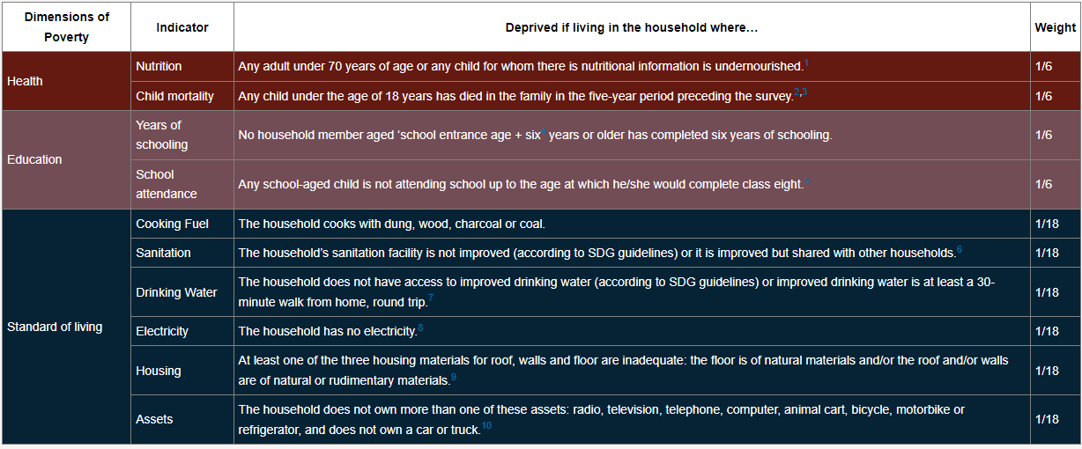
MPI
Source: OPHI 2020 MPI
https://hdr.undp.org/en/2020-MPI
Copyright Bananaomics

Slide 35
United 4 Social Change - Human Development Index

Slide 36
Challenges in Measuring Poverty
Copyright Bananaomics

Slide 37
Take 2-3 minutes and discuss with a partner what you believe the difficulties researchers face when measuring poverty.
Copyright Bananaomics

Slide 38
Challenges in Measuring Poverty
Imperfect Data
Intra-Household Poverty
By measuring poverty on a household basis, individual poverty is not included. For example, women in households may lack access to resources more than their male counterparts.
Urban Poverty
Most poverty measurements are based on rural poverty and don't take into account to goods and services available in cities (public transport, water fountains, public bathrooms).
Disaggregated Poverty Data
Minimum Income Standards
Each country typically has its own poverty line which can be used to determine the number of people in poverty.
Copyright Bananaomics

Slide 39
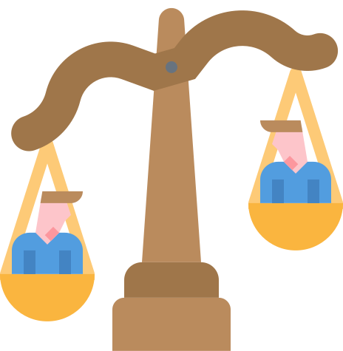
Causes of Economic Inequality and Poverty
Copyright Bananaomics

Slide 40
Causes of Poverty and Economic Inequality
Inequality of Opportunity
People in the same society don't have access to the same opportunities. Positions in society with wealth, power, and status are more likely to have greater opportunities.
Resource Ownership
Wealth inherited in the form of stocks or property gives some greater advantages compared to low-income citizens.
Different levels of Human Capital
State sectors often struggle to ensure a high quality of education leading to low levels of human capital in society. Those able to afford private education are likely to have higher levels of human capital.
Copyright Bananaomics

Slide 41
Causes of Poverty and Economic Inequality
Discrimination
Discrimination through hiring practices and payment for services often leads to certain groups being disproportionately disadvantaged. (Gender Pay Gap, Hiring demographics)
Unequal Status and Power
Cultural status and power play a large role in inequality. Cultural ideas about certain groups being "better" than others determine relationships, jobs, school placements, etc.
Government Taxation and Benefits
Certain policies favor individuals with high wealth and income. Those that have the majority of money in stocks/bonds pay a lower percentage of capital gains compared to income.
Copyright Bananaomics

Slide 42
Causes of Poverty and Economic Inequality
Globalization and Technological Change
With increasing globalization and changes in technology, certain countries are left behind without desirable training or skills leading to increases in unemployment.
Market-Based Supply-Side Policies
These policies aim to increase LRAS by increasing competition, labour reform, and increasing incentives. However, these policies can also further inequality. (Examples: Tax/Business Cuts, reducing unemployment, reducing minimum wage)
Copyright Bananaomics

Slide 43
The Impact of Income and Wealth Inequality
Copyright Bananaomics

Slide 44
Impact of Income and Wealth Inequality
Economic Growth
Economic growth is lower with poor income equality. Consumption and productivity are lower than potential.
Standards of Living
Reductions in income lead to a fall in standards of living and serve as an obstacle to economic development.
Social Stability
Individuals and countries who do not have adequate levels of health care or education struggle in their respective societies.
Copyright Bananaomics

Slide 45
The Role of The Government to Reduce Poverty, Income Inequality, and Wealth Inequality
Copyright Bananaomics

Slide 46
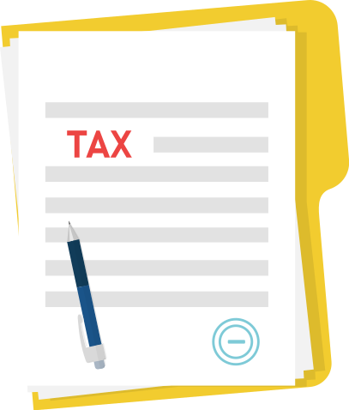
Taxation
Copyright Bananaomics

Slide 47
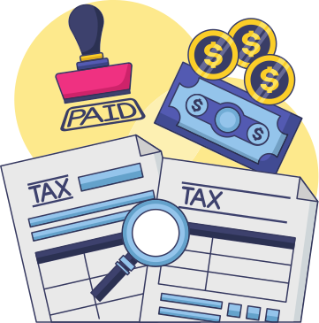
Taxation
Taxation has the ability to aid or further income and wealth inequality.
Indirect Taxes - Regressive in nature and theoretically increase economic inequality.
Direct Taxes - Progressive in nature and has the ability to redirect money to areas of need.
Copyright Bananaomics

Slide 48
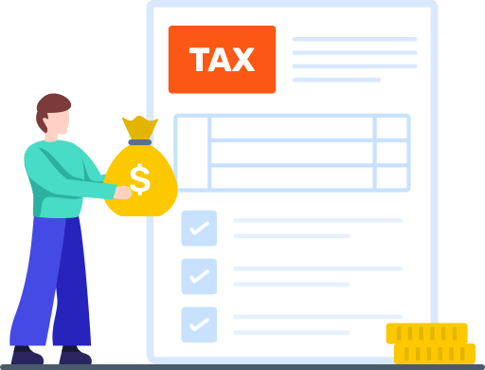
Taxation
Direct Taxation to Reduce Economic Inequality
Personal Income Tax - Takes a higher portion of income from high earners and redistributes money to lower earners.
Corporate Income Tax - Similar to Personal Income Tax but for corporations. Although corporate tax cuts could theoretically lead to greater employment, research estimated the richest 1% benefit the most.
Wealth Tax - Wealth taxes are directed at an individual's assets such as real estate, cash, bank deposits, etc. The goal of a wealth tax is to reduce the accumulation of wealth and redistribute money to individuals with low wealth.
Copyright Bananaomics

Slide 49
Taxation
Indirect Taxation to Reduce Economic Inequality
Luxury Tax - Reduced VAT/GST tax on necessity goods such as food, water, medical care, or public transport aims to reduce the proportion of tax paid by poor households.
Copyright Bananaomics

Slide 50
Government Policies
Copyright Bananaomics

Slide 51
Inequality of Human Capital
Governments may try to ensure fair access to resources to reduce inequality
Funding for certain schools in low-income areas
Scholarships, grants, loans, or free university
Providing some type of universal access to health care
Offering training programs and job assistance
Copyright Bananaomics

Slide 52
Inequality of Human Capital
Governments may use Transfer Payments (direct payments from the government to individuals to redistribute income)
Types of Transfer Payments
Pensions for older individuals
Unemployment benefits
Child allowances (free meals at schools)
Universal Basic Income (UBI)
Copyright Bananaomics

Slide 53
Inequality of Human Capital
Additional government policies to reduce economic inequality
Targeted spending
Spending on education, health care, and infrastructure in low-income communities
Policies to Reduce Discrimination
Governments may implement legislation to protect certain groups typically discriminated against such as racial minorities, senior citizens, and those who identify as a non-dominant gender.
Minimum Wages
While minimum wages do result in higher levels of unemployment, it also results in higher standards of living for those employed.
Copyright Bananaomics

Slide 54
Practice Question
Copyright Bananaomics

Slide 55
Paper 1
M18/03/ECONO/SP1/ENG/TZ1/XX
Copyright Bananaomics

Slide 56
Mark Scheme
Copyright Bananaomics

Slide 57
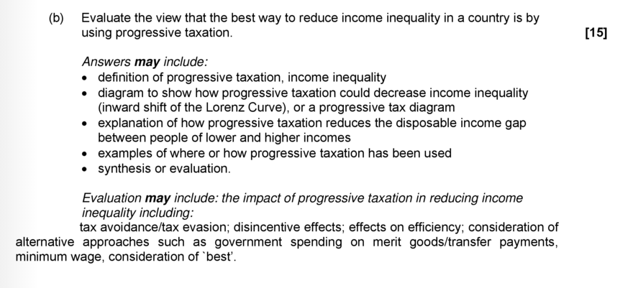
Mark Scheme
Copyright Bananaomics

Slide 58
Enjoying The Content?
Visit bananaomics.com to purchase package deals with discount prices!
BANANAOMICS

